Slide 1
IOT Sights
Students: Rafi Taub (taubrafi@gmail.com)
Nick Kuhlik (nick.kuhlik@gmail.com)
Supervisor: Moni Orbach
Semester: Spring 2016

Slide 2
Introduction
The modern assault rifle sights are an optical device that is lacking in features.
The relay of tactical information in the field, back to the high command is mostly done by speech over the radio.
By integrating smart IOT devices in the gear of the modern infantry, we can transmit back vital data that can help decision making.

Slide 3
Project Goals
Create a device that transmits GPS and position in space, to a server to intersect the data from several devices and show the result.
Learn how to develop code for microcontrollers.
Produce a PCB.
Create a website for visualization and data parsing.

Slide 4
Solution Requirements
An embedded device that will be mounted on a Blue force rifle. Sending tactical information such as position and location via the internet for the commander to make decisions based on deduced position of Red force.

Slide 5
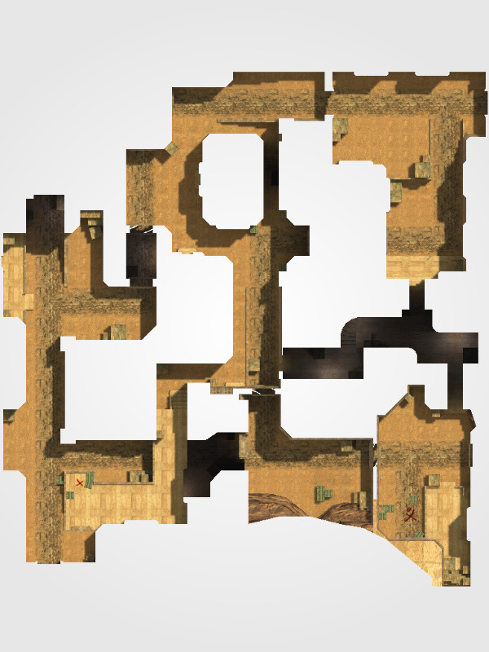
Diagram Visualization
In this diagram:
We can see the blue
Force location and the
Direction of their sights
When the trigger was
Pulled.
We could deduce
The positions of the red
Force.
soldier position
Red force possible position
Line of sight at trigger pull

Slide 6
Animated diagram
soldier position
Red force possible position
Line of sight at trigger pull

Slide 7


Block Diagram: Overview
Data creation
Collection and analysis
Decision making
Algorithm on the AWS cloud
GPS and MEMS data from each
HMI

Slide 8
Block Diagram: Embedded Device
microcontroller
Internet access
MEMS – position in space
GPS- Location in space
Trigger Pull detector
storage

Slide 9
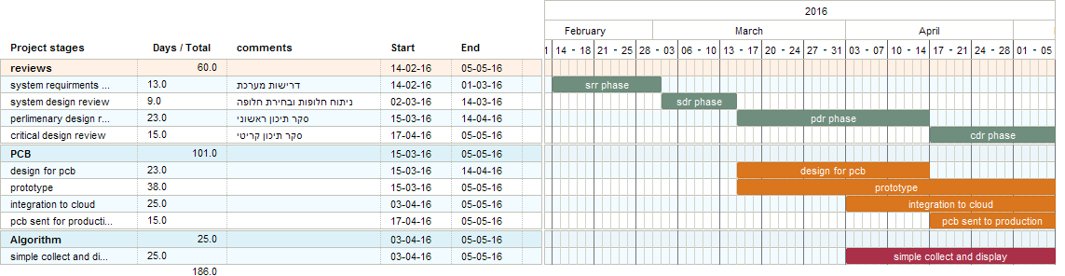
Project Gantt – until mid semester
In the SRR phase we will collect the requirements for the IOT sights, deciding the crucial parts and the “nice to have” ones.
In the SDR phase we will propose different solutions that satisfy the requirements for the project and choose the best solution based on the weights given to each requirement
In the PDR phase we will create the designs that will be used for manufacturing after the CDR and base our model from lessons learned from making a first iteration of breadboard prototype
In the CDR phase we connect the singular system prototype to the cloud to deliver the full functionality.
The conclusion of all of those stages will bring us to the midterm presentation .

Slide 10
PDR readiness
According to the Gantt:
The Prototype is on schedule.
The cloud integration is ahead of schedule
The PCB production is 2 weeks behind schedule (didn’t include Passover into the calculations)

Slide 11
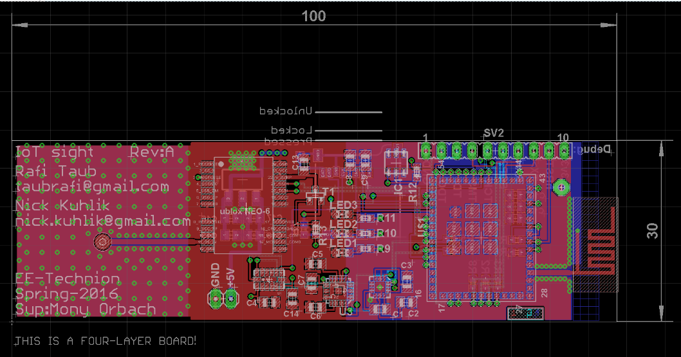
The PCB
The PCB is sent into manufacturing.
3 PCB’s will be created for testing and further work.
Code is located at https://github.com/taubrafi/IoTsightembedded/tree/CC3200v2

Slide 12
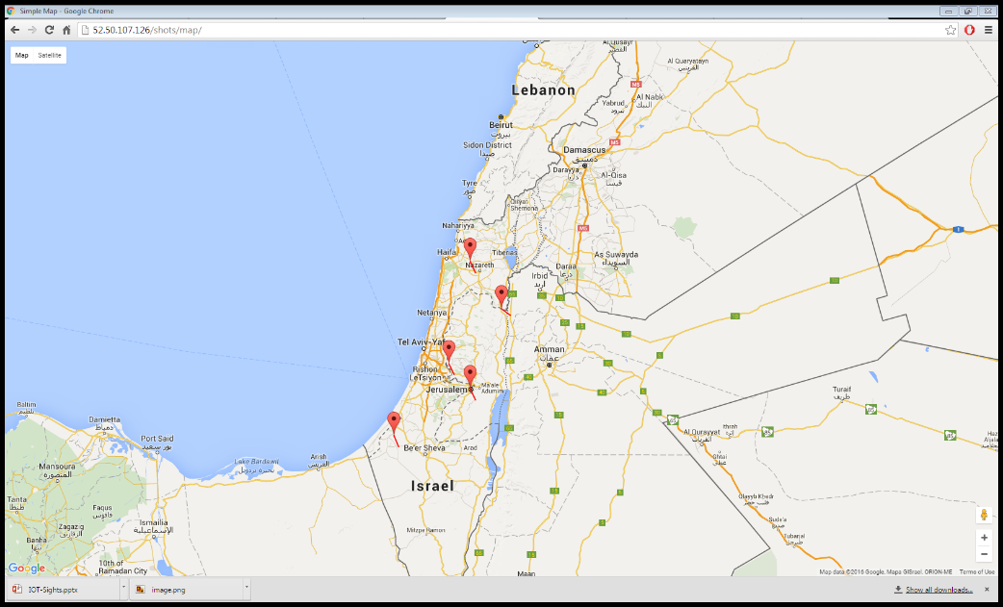
The
Site is located at http://52.50.107.126/ using AWS cloud.
Code is located at https://github.com/sudo-Whateverman/IOTsights

Slide 13
Future plans
Integration Tests on PCB.
Create a printed enclosure for the PCB and power supply.
Test the device in “field conditions”.
Add css to the website.
Create version description document and signoff.

